Slide 1
PROPOSALS

Slide 2
WHAT IS A PROPOSAL?
A proposal is an offer to do something or a recommendation that something be done.
A proposal’s purpose is to persuade readers to improve conditions, authorize work on a project, accept a service or product, or otherwise support a plan for solving a problem or doing a job

Slide 3
Why do we write proposals?
They are written for decision makers: managers, executives, directors, clients, trustees, board members, or community leaders.
Proposals decide:
whether your suggestions are worthwhile,
whether your project will materialize,
Whether your product is usuaful.

Slide 4
What is the Process of Proposal?
The process has three stages:
Client X needs a service or product
Firms A, B, and C propose a plan for meeting the need
Client X awards the job to the firm offering the best proposal

Slide 5
Proposals are classified into categories
There are three classifications:
Origin
Audience
Intention

Slide 6
Based on Origin
Solicited
Unsolicited

Slide 7
Solicited Proposals
When a company has a particular problem to be solved or a job to be done, it will solicit, or invite, proposals.
The company will notify you and other competitors by preparing a request for proposals (RFP),
which is a set of instructions that specify the exact type of work to be done along with guidelines on how and when the company wants the work completed.

Slide 8
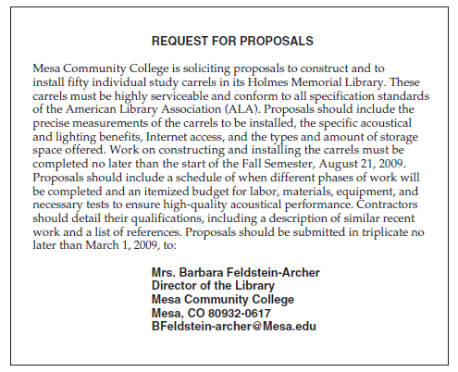

Slide 9
Unsolicited Proposals
With an unsolicited proposal, you—not the reader—make the first move.
Unlike a solicited proposal, in which the company to which you are submitting the proposal knows about the problem,
your unsolicited proposal has to convince readers that
(1) there is a problem and
(2) you and your firm are the ones to solve it.

Slide 10
Based on Audience:
Internal Proposal
External Proposal

Slide 11
Internal Proposals
An internal proposal is written to one or several decision maker(s) in your own organization who have to sign off or approve your plan.
An internal proposal can deal with a variety of topics, including changing a policy or procedure, requesting additional personnel, or purchasing or updating equipment or software.

Slide 12
External Proposals
An external proposal is sent to a decision maker outside your company.
It might go to a potential client you have never worked for or to a previous or current client.
An external proposal can also be sent to a government funding agency.
External proposals tend to be more formal than internal ones.

Slide 13
Based on Intention:
Planning: Suggests ways of solving a problem or bringing about improvements. It answers the following question:
What are the benefits of following your suggestions.
Research: or grant proposal request approval and funding for a research project
Sales: It offers a service or product. They are usually external proposals.

Slide 14
Guidelines for Writing a Successful Proposal
1. Approach writing a proposal as a problem-solving activity.
Everything in your proposal should relate to the problem, and the organization of your proposal should reflect your ability to solve problems.
2. Regard your audience as skeptical readers.
Even though you offer a plan that you think will benefit readers, do not be overconfident that they will automatically accept it as the best and only way to proceed.
3. Research your proposal thoroughly.
You will have to research your topic by shopping for the best prices, comparing prices and services, verifying schedules, visiting customers, making site visits, and interviewing
4. Scout out what your competitors are doing.
Become familiar with your competitors’ products or services, have a fair idea about their market costs, and be able to show how your company’s work is better

Slide 15
5. Prove that your proposal is workable.
The bottom-line question from your reader is “Will this plan work?” Your proposal should contain no statements that say, “Let’s see what happens if we do X or Y.”
6. Be sure your proposal is financially realistic.
Is it worth the money?
7. Be ethical.
Don’t misinterpret your product or service by exaggerating its benefits
8. Package your proposal attractively
Make sure that your proposal is well presented: inviting, attractive, and easy to read.

Slide 16
A general Model for Proposal
Introduction
Statement of problem
Background
Need
Benefits
Qualifications of Personnel
Data Sources
Limitations
Scope
Body
Conclusion

Slide 17
Body of the Proposal
Methods
Timetable
Material and Equipment
Personnel
Available Facilities
Needed Facilities
Cost
Expected Results
Feasibility

Slide 18
Conclusion of the Proposal
Summary of the key points
Request for Action

